Slide 1


PHARMACY DATABASE
SAMUEL ROBERT - 26
AAKASH SARDAL - 31

Slide 2
Description
1. Pharmacy database system is an online application from which user can easily manage the medicine and pharmacy details in a convenient manner.
2. Both staffs and customers can easily get their work done because of database management system.
3.The projects aim is to consider all the elements of a pharmacy and apply it on a database management system, for example, the admin can track all information of the supplier, medicines and their employees at a single portal.
4.The database will not only contain information but we can even add, edit, delete and update the records of all the customers, employees, suppliers and the inventories of that particular pharmacy.

Slide 3
ENTITIES | ATTRIBUTES
Customer | (C_name, C_address, contact_no, CID )
Supplier | (S_name, supplier_ID, S_address)
Inventory | (Drug_id, Drug_name, unit , unit_price)
Item | ( item_id, expiry, status)
Orders | (order_id, order_date, total_unit, total_price)
Employee | (Employee_name, Employee_ID)

Slide 4
Relationship sets:
Supplier supplies item : supplier with item : 1:N , both total
Item have orders : item with orders : M:1, item total, order partial
Item in inventory : Item with inventory : M:1, item partial, inventory total
Order taken_by employee : Order with employee : M:1 order partial, employee total
Order given_by customer : order with customer : M:1, both total

Slide 5
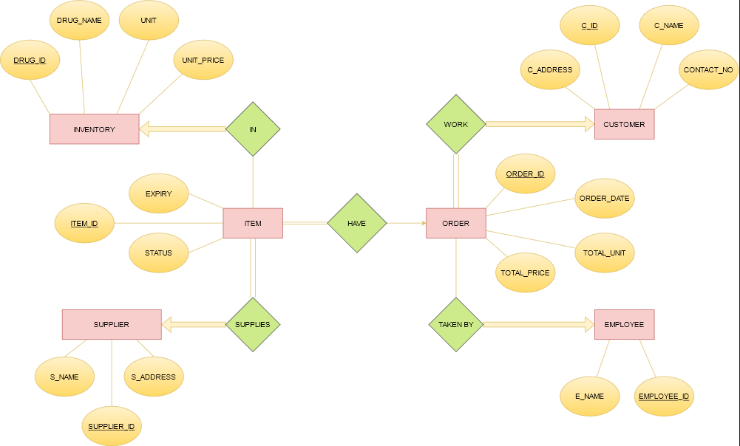
ENTITY-RELATIONSHIP DIAGRAM

Slide 6
RELATIONAL MODEL
Customer | (C_name, C_address, contact_no, customer_ID )
Supplier | (S_name, supplier_ID, S_address )
Inventory | (Drug_id, Drug_name, unit, price)
Employee | (Employee_name, Employee_ID)
Orders | (order_id, order_date, quantity, total_price, customer_id*, Employee_ID*)
Item | (item_id, expiry, status, supplier_ID*, Drug_id*, order_ID*

Slide 7
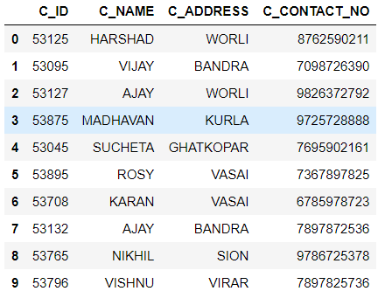
SAMPLE TABLES CUSTOMER

Slide 8
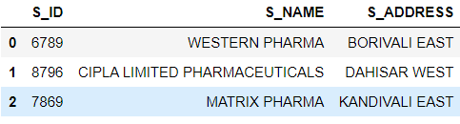
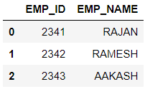
SUPPLIER EMPLOYEE

Slide 9
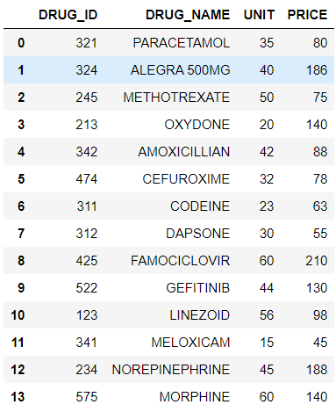
INVENTORY

Slide 10
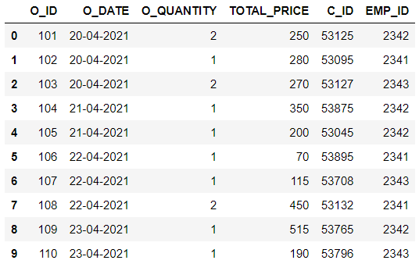
ORDER

Slide 11
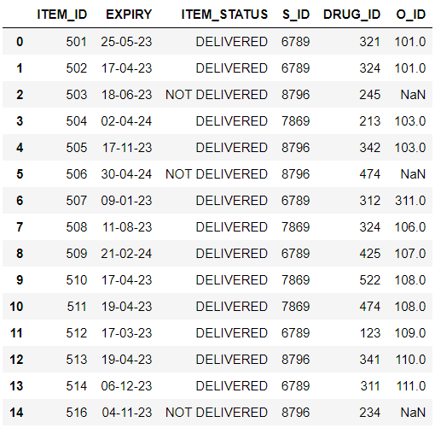
ITEM

Slide 12
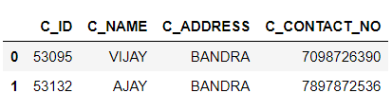
SQL QUERIES
1) WAQ TO DISPLAY CUSTOMER DETAILS WHO ARE FROM BANDRA :
SELECT *
FROM CUSTOMER
WHERE C_ADDRESS = 'BANDRA‘

Slide 13
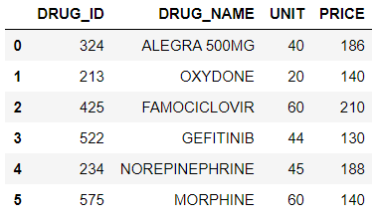
2) WAQ TO DISPLAY THE DETAILS OF DRUGS WHOSE PRICE IS GREATER THAN 100.
SELECT *
FROM INVENTORY
WHERE PRICE > 100

Slide 14

3) WAQ TO DISPLAY THE NUMBER OF ITEMS WHICH HAS BEEN DELIVERED
SELECT ITEM_STATUS, COUNT(ITEM_STATUS)
FROM ITEM
GROUP BY ITEM_STATUS

Slide 15
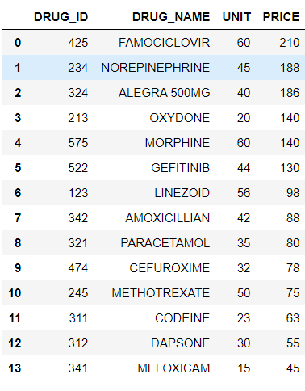
4) WAQ TO DISPLAY DETAILS WITH UNIT PRICE IN DESCENDING ORDER
SELECT *
FROM INVENTORY
ORDER BY PRICE DESC

Slide 16
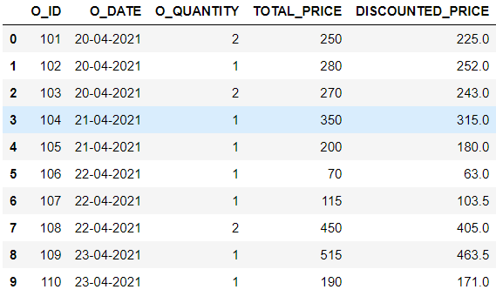
5) WAQ TO DISPLAY DISCOUNTED PRICE ALONG WITH ALL ATTRIBUTES OF ORDERS.
SELECT O_ID, O_DATE, O_QUANTITY, TOTAL_PRICE, TOTAL_PRICE - (TOTAL_PRICE * 0.1) AS DISCOUNTED_PRICE
FROM ORDERS

Slide 17
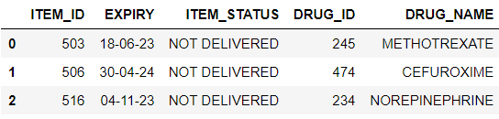
6) WAQ TO FIND THE DETAILS DRUG WHICH HAS NOT BEEN DELIVERED.
SELECT U.ITEM_ID, U.EXPIRY, U.ITEM_STATUS, I.DRUG_ID, I.DRUG_NAME
FROM INVENTORY AS I NATURAL JOIN ITEM AS U
WHERE U.ITEM_STATUS = 'NOT DELIVERED'

Slide 18

7) WAQ TO DISPLAY THE DETAILS OF THE SUPPLIER WHO SUPPLIES THE ITEMS WHICH HAVE LESS THAN 20 UNITS IN THE INVENTORY.
SELECT *
FROM SUPPLIER
WHERE S_ID IN
(SELECT S_ID
FROM ITEM
WHERE DRUG_ID IN
(SELECT DRUG_ID
FROM INVENTORY
WHERE UNIT < 20))

Slide 19

8) WAQ TO DISPLAY ITEM DETAILS SUPPLIED BY THE SUPPLIER HAVING SUPPLIER ID 8796.
SELECT *
FROM ITEM AS I NATURAL INNER JOIN SUPPLIER AS S
GROUP BY S_NAME
HAVING S_ID = 6789

Slide 20
9) WAQ to Simulate Full Outer Join between ORDERS and EMPLOYEE.
SELECT *
FROM ORDERS AS O NATURAL LEFT OUTER JOIN EMPLOYEE AS E
UNION ALL
SELECT *
FROM EMPLOYEE AS E NATURAL LEFT OUTER JOIN ORDERS AS O

Slide 21
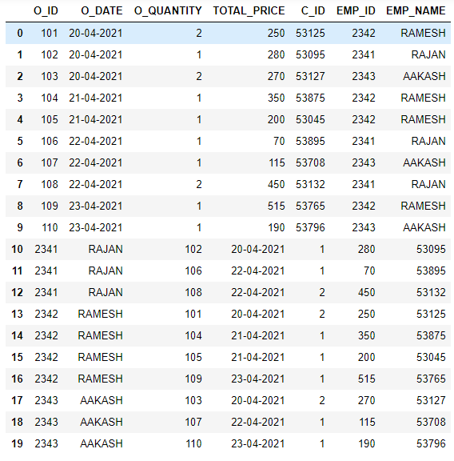

Slide 22

10) WAQ TO DISPLAY THE CUSTOMER WHO HAS ORDERED PARACETAMOL FROM THE EMPLOYEE.
SELECT C.C_ID, C.C_NAME, C.C_ADDRESS, C.C_CONTACT_NO, V.DRUG_NAME, E.EMP_NAME
FROM CUSTOMER AS C , ORDERS AS O, ITEM AS I, INVENTORY AS V, EMPLOYEE AS E
WHERE I.O_ID = O.O_ID
AND O.C_ID = C.C_ID
AND I.DRUG_ID = V.DRUG_ID
AND E.EMP_ID = O.EMP_ID
AND V.DRUG_NAME = 'PARACETAMOL‘

Slide 23
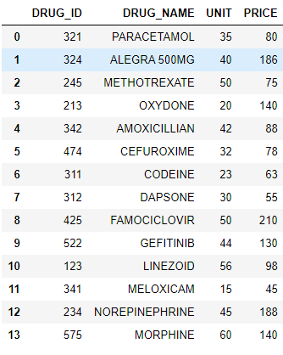
11) WAQ TO UPDATE THE UNIT OF FAMOCICLOVIR FROM INVENTORY.
UPDATE INVENTORY
SET UNIT = 50
WHERE DRUG_ID = 425
SELECT *
FROM INVENTORY

Slide 24
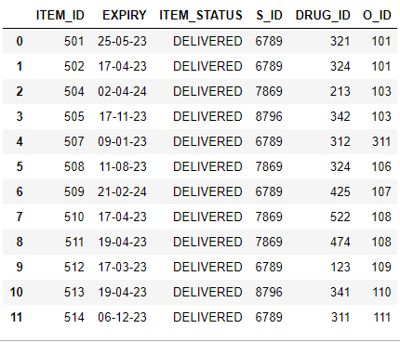
12) WAQ TO DELETE ITEM DETAILS WHOSE ITEM STATUS IS 'NOT DELIVERED'.
DELETE FROM ITEM
WHERE ITEM_STATUS = 'NOT DELIVERED'
SELECT *
FROM ITEM

